Slide 1


The Great ILS-Data Pre-Conference
Quick Lessons With Your Peers
https://github.com/iug-ils-data-preconf/iug2026

Slide 2

Today’s Agenda
1:00 - 2:30: Speed Geeking
2:30 - 3:00: Afternoon Break
3:00 - 3:15: Thousands of Tables and Four Farthings:
Hacking Your Way to a Better Report
3:15 - 3:30: AMH Insights:
Turning Log Files Into Actionable Data
3:30 - 3:45: Building a Data Lake for Your Library:
Early Experiments at CHPL
3:45 - 4:00: Putting Privacy First:
Making Due with Less Data
4:00 - 5:00: Panel Discussion

Slide 3
A Brief Guide To Speed Geeking
There are 7 stations around the room
When we start, you will have 5 minutes to decide which presentation you wish to see.
Presentations will last 15 minutes
You will then have 5 minutes to move to another station
We will do this for 4 cycles

Slide 4



Speed Geeking: Presentations
(Jeremy Goldstein) Dashboard Confessional:
Revealing the Secrets of Data Visualization
(Derek Brown) Vega Kiosks
(Bob Gaydos) Python Command Line Processing
with argv[] and the argparse Module

Slide 5




Speed Geeking: Presentations
(Daniel Messer) Out Here in the Fields:
Lessons Learned from a Different Database
(Wes Osborn) Finding Signal in
the Noise with Regex
(Ray Voelker) I ❤ Datasette: Collection
Analysis & the Newsdex Project at CHPL
From Create Lists to Action: Empowering
Staff with API-Driven Micro-Projects

Slide 6
Thousands of Tables and Four Farthings
Hacking Your Way to a Better Report
The Great ILS-Data Pre-Conference
Daniel Messer
Polaris ILS Administrator
Library Systems & Services

Slide 7
Hello, I’m Dan
I like bright text on dark backgrounds

Slide 8
Hello, I’m Dan
I like bright text on dark backgrounds
30 years in libraries
Polaris ILS admin for Library Systems & Services
SQL Hacker (as will soon be made clear)

Slide 9

https://cyberpunklibrarian.com/iug2026

Slide 10
Beginning at the Beginning – WTF is Four Farthings?
De-centralized central data server
Wait what?
I have a weird relationship with libraries and Polaris
I do not help manage Polaris for a library or a consortium
I help manage Polaris for 27 libraries
10 of which are in consortia (of which there are two)
We would like to be able to do things with the data between them
But we don’t want to move that data around

Slide 11
Okay, sure but why Four Farthings?
My boss is a huge fan of Lord of the Rings
Me, I love Lord of the Rings
But she has forgotten more about Lord of the Rings than I know
Rumour has it that she read The Silmarillion and enjoyed it
All that to say, is that The Shire is divided into four parts
The Four Farthings

Slide 12
The Problem
The Finance Department
No that’s it, they’re the problem
Okay they run this report to get paid invoices, right?
But do they do it through SSRS?
No
Through the Polaris reporting system?
No
SimplyReports?
No

Slide 13
The Problem – Continued
No, they run a custom SQL query in the Find Tool
Select all the Invoices
Right-click
Select Print -> Full
A PDF appears from… somewhere
Yeah…

Slide 14
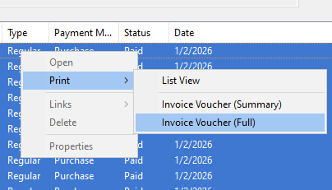

Slide 15
Analysis
So this is obviously coming from some kind of internal reporting process
But where is it and how does it work?

Slide 16

Solution

Slide 17
Where’s the Call Coming From?
Inside the house, obviously
So let’s trace the call

Slide 18
SQL Server Profiler
A separate programme that works with SQL Server
Allows you to do a SQL Trace
Watch everything that’s happening in your database
Set up and run the search in the Find Tool
Start the trace
Select and print the full invoice vouchers
Stop the trace
Look for clues

Slide 19
Interesting Finds
exec ObjectExists @Path=N'/Polaris/System/Internal/Vouchers1',@AuthType=1
exec Polaris.Rpt_Vouchers1 @InvoiceID=1,@PayHistoryID=1,@sTempTable=N'##6_861’
Ran a search on that @Path and, oh hey:
C:\ProgramData\Polaris\{POLARIS VERSION}\Reports\System\Internal

Slide 20
SQL Server Extended Events
The SQL Profiler Trace casts a very wide net but…
Now we have some idea of which fish we want to catch
Time for Extended Events
Set up a search
sql_batch_completed
rpc_completed
These capture sproc calls and ad-hoc queries
Filter by username. In this case: polaris

Slide 21
More Interesting Finds
Looking through the captured data, you can see the order
declare @p3 nvarchar(255) set @p3=N'##1158_861' exec Polaris.Rpt_CreateTempTable 861,1158,@p3 output select @p3
exec Polaris.Rpt_Vouchers1 @InvoiceID=1,@PayHistoryID=1,@sTempTable=N'##1158_861’
exec Polaris.Rpt_VoucherLines @invoiceid=317773,@payhistoryid=325569

Slide 22
So what did we discover?
There’s an internal report, not shown in SSRS, called Vouchers1
There are three sprocs involved:
Rpt_CreateTempTable
Rpt_Vouchers1
Rpt_VoucherLines
And we can look at the way the sprocs are called and compare that with their code to find out what parameters they take
Rpt_CreateTempTable takes the PolarisUserID, WorkstationID, and a table name
Which means it creates a predictably named table

Slide 23
Know the Process, Hack the Process
We need to create our own temp table
EXEC Polaris.Polaris.Rpt_CreateTempTable 861,1158,@p3 OUTPUT;
Populate the table with our own SQL query, the same one Finance was using but with variable start and end dates
EXEC Polaris.Polaris.Rpt_Vouchers1 @InvoiceID = 1, @PayHistoryID = 1, @sTempTable = N'##1158_861’
But wait! What about Rpt_VoucherLines?
Turns out, it’s only used as a sub-report in the Vouchers1 RDL file

Slide 24
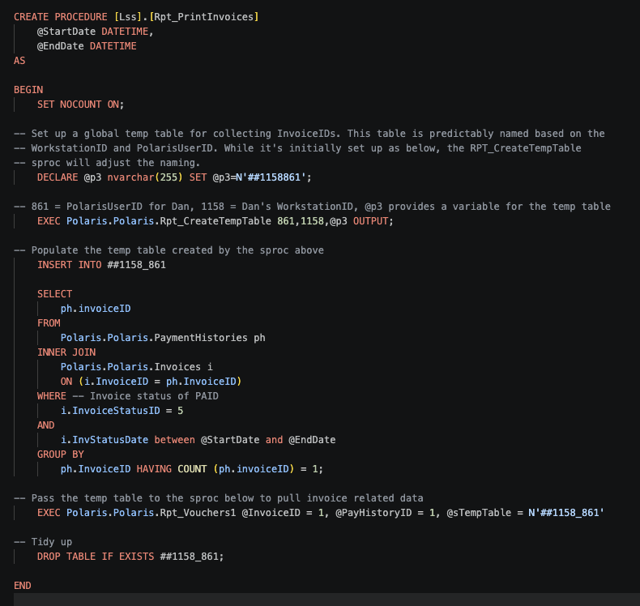

Slide 25
Thank you!

Slide 26
AMH Insights: Turning Log Files Into Actionable Data
Victor Zuniga
Poudre Libraries
vzuniga@poudrelibraries.org

Slide 27
The Problem
AMH systems move thousands of items daily
Limited visibility into routing decisions
Exceptions are difficult to explain
Staff questions → no clear answers
Notes:
Let’s start with the problem. Our AMH systems are doing a ton of work behind the scenes, moving thousands of items every day. But when something goes wrong, or even when we’re just curious, we don’t actually have great visibility into how those decisions are being made. Especially when items fall into exceptions, it becomes really difficult to explain why.

Slide 28
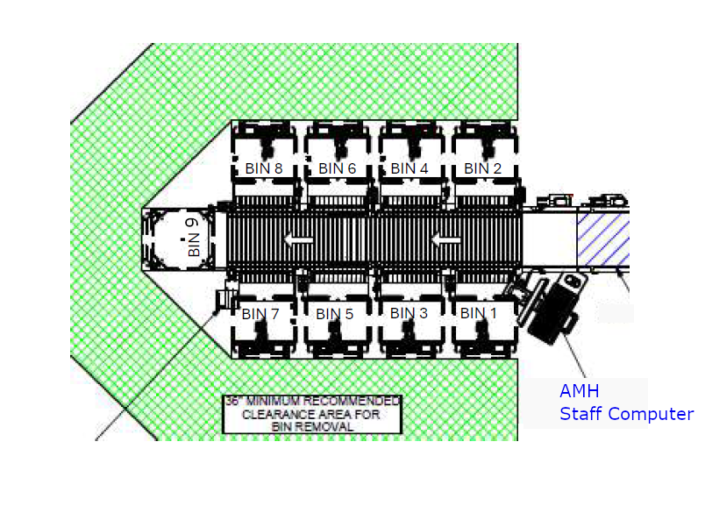
The Environment
Multiple bins (holds, transit, exceptions, etc.)
Rules-based routing
Physical + logical complexity
Notes:
Here’s what that environment looks like. We have multiple bins, each serving a different purpose, holds, transits, exceptions, and so on. Behind the scenes, there are rules driving how items move through this system. So what looks simple physically is actually fairly complex logically.

Slide 29
The Black Box
Decisions happen in the AMH system
Limited transparency
Difficult to validate behavior
Notes:
Item → AMH → Bin (unknown)
Item → Data → Logic → Bin (visible)
From our perspective, the AMH can feel like a bit of a black box. Items go in, decisions are made, and they end up in a bin. But we don’t always have a clear way to validate or explain those decisions.

Slide 30
The Hidden Data (Logs)
SIP2 transaction logs
Every check-in is recorded
Contains routing-related fields
Notes:
AMH System → SIP2 Logs → Transactions
Every check-in is logged
Rich but unstructured
But here’s the interesting part, the system is actually logging everything. Every check-in transaction is recorded in SIP2 logs. These logs contain a lot of useful fields, including information that relates to how items are being routed.

Slide 31

What Does a Log Look Like?
AB → Barcode
AQ → Location
AJ → Title
CT → Destination
Notes:
Here’s an example of what one of those logs looks like. At first glance, it’s not very friendly. But once you start breaking it down, you can identify key pieces of information, like the barcode, title, and location data.

Slide 32
The Key Insight
Logs ≠ Bin
Logs contain location data
Routing must be reconstructed
Notes:
Logs ≠ Bin
Logs → Location → Bin (via sorting matrix)
Here’s the key insight. The logs don’t actually tell us the bin. Instead, they give us location data. So, if we want to understand routing, we need to reconstruct it.

Slide 33
Sorting Matrix
Sorting Matrix (CSV)
Maps location → bin
Supports rules (exact + wildcard)
Notes:
Reference your matrix concept (rstCCT.csv)
Maps location → bin
Supports exact + wildcard rules
* → Bin 0 (Exceptions)
This is where the sorting matrix comes in. It acts as the brain of the operation. It maps location codes to bins and defines how items should be routed. Once we combine this with the logs, we can start reconstructing what actually happened.

Slide 34
Reconstructing the Workflow
Parse SIP2 logs
Extract location data
Apply sorting matrix
Assign expected bin
Compare results
Notes:
Logs → Parse → Extract → Matrix → Expected Bin → Analyze
So now we can put it all together. We parse the logs, extract the location data, apply the sorting matrix, and assign an expected bin. From there, we can compare what we expect versus what actually happened.
Understanding Exceptions
Match → Bin X
No match → Bin 0 (Exceptions)

Slide 35
What This Enables
Bin usage analysis
Exception tracking
Troubleshooting
Data-driven decisions
Notes:
Once we have that, a lot of things open up. We can analyze bin usage, track exceptions, troubleshoot issues, and start making more informed decisions about how the system is performing.

Slide 36
Existing Data
Sierra DNA (circ_trans)
Decision Center reports
Limited AMH visibility
Notes:
We already have reporting tools like Sierra DNA and Decision Center. These are great for circulation activity, but they don’t give us insight into how the AMH system is actually routing items.
Sierra DNA
- Circ_trans table view
-- Op_code
-- Application_name
-- Source_code
Decision Center
-- Collection Tools > Evaluation > Statistics Group by Transaction Type
-- Collection Tools > Evaluation > Hourly Circulation by Transaction Type

Slide 37
The Gap
Circulation Data ≠ Routing Insight
No bin-level insights
No exception tracking
Notes:
So there’s a gap. We can see what’s circulating, but not how items are moving through the AMH system itself.

Slide 38
Why This Matters
Better troubleshooting
Improved workflows
Data-driven decisions
Staff confidence
Notes:
At the end of the day, this is about visibility. Understanding how items move through the system helps us troubleshoot issues, improve workflows, and give staff better answers when questions come up.

Slide 39
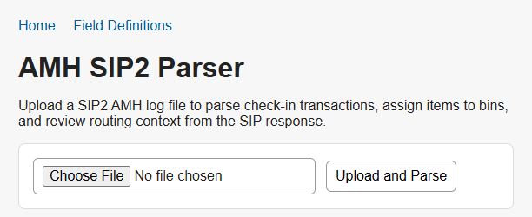
Demo

Slide 40
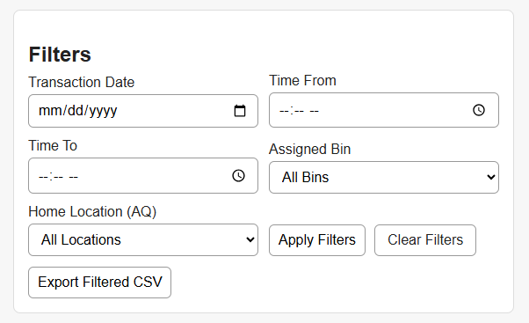
Demo

Slide 41
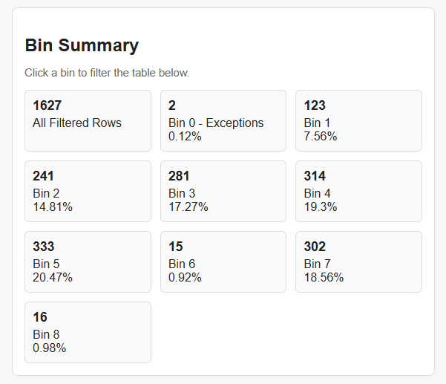
Demo

Slide 42
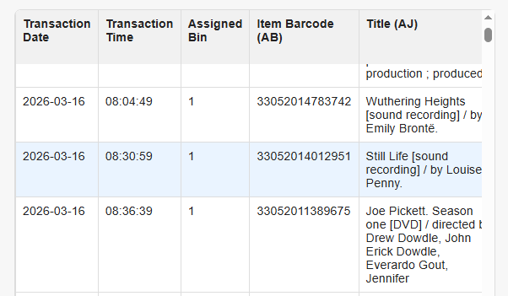
Demo

Slide 43
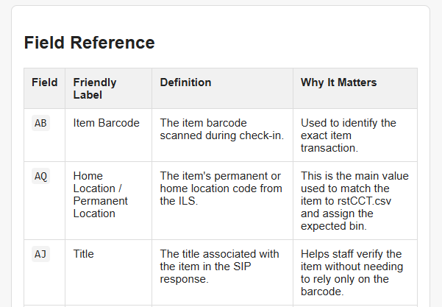
Demo

Slide 44
Thank You!
Victor Zuniga
Poudre Libraries
vzuniga@poudrelibraries.org

Slide 45
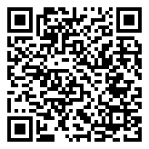

Building a Data Lake for Your Library
Early Experiments at CHPL
Ray Voelker
Cincinnati & Hamilton County Public Library
ray.voelker@chpl.org
Notes:
Click on QR code to bring up presentation

Slide 46
Putting Privacy First: Making Due with Less Data
Jeremy Goldstein
Minuteman Library Network
jgoldstein@minlib.net
Notes:
This afternoon we’ve been sharing information on all the cool things that can be done with the data in our systems. Now I’m to be the bummer and talk a bit about why you may want to think twice about some of those efforts and provide some examples of ways to accomplish your organizational data needs while foregrounding the privacy of your patrons data.

Slide 47
Massachusetts Law
That part of the records of a public library which reveals the identity and intellectual pursuits of a person using such library shall not be a public record as defined by clause Twenty-sixth of section seven of chapter four.
-Massachusetts General Laws Chapter 78, Section 7
Notes:
Full disclosure up front, my perspective on these issues is coming from living in Massachusetts where I don’t know if you’ve heard but we’re pretty leftist. I’m personally represented in Congress by Elizabeth Warren and Katherine Clark and one of the cities within our consortia is the People’s Republic of Cambridge. That brings with it a certain baseline attitude to our practices that may not match with a lot of libraries elsewhere.
To start out, here we have the Mass. Law governing library data, which currently forms the basis for most library policies.

Slide 48
Policy Interpretation
This law extends to circulation records (borrowing records, registration records, reserves or fine records), information sought or received, materials consulted, interlibrary loan transactions, registration records, database search records, reference interviews, or any other personally identifiable uses of library materials, facilities or services of its patrons. In accordance with this law, the Somerville Public Library will not disclose or make available any circulation information, registration information, or information retrieval records in response to any inquiry except
To the cardholder (with library card or proper id). This applies regardless of age or relationship, and staff is therefore restricted from disclosing information to the parents of minors when the minor has their own library card;
To persons authorized by the cardholder to access the individual’s records by providing such persons with their physical library card or the card’s barcode scanned into their cell phone;
By library authorities acting within the scope of their duties for the purpose of interlibrary cooperation and coordination as authorized by M.G.L. c. 78, section 7; or
To representatives of any local, state, or federal government, pursuant to subpoena, order or search warrant authorized under the authority of federal, state, or local law relating to civil, criminal, or investigative power. Upon receipt of any such subpoena, order or search warrant, the library administration will consult with legal counsel to determine if it is proper to release the requested confidential information.
https://somervillepubliclibrary.org/library/policies/privacy-and-confidentiality/
Notes:
And here we have a portion of the privacy policy in place at the Somerville public library in our network. The key example here I’ve highlighted is the interpretation that the patron records of minors, dependents, absolutely anyone cannot be shared with their guardians in most cases…that interpretation of the law is held pretty broadly and prevents us from using fairly standard features of the ILS like linked patrons…no matter how much our patrons may actually want that. There are some allowances, generally if a parent is holding their child’s card it’s assumed the child has granted permission and staff don’t push back too much…but that level of record protection is the goal.

Slide 49
Massachusetts Data Privacy Act
Senate Bill S.2619 https://malegislature.gov/Bills/194/S2619
House Bill H.4746 https://malegislature.gov/Bills/194/H4746
Data minimization first approach to privacy
Limit Data Collection to what is:
Reasonably necessary to provide services
Strictly necessary for sensitive personal data
Greatly expands on what is considered sensitive data
Ensures consumers have rights to view, correct and delete their data
Sets new requirements and penalties for compliance
Notes:
That’s where we are now but currently we’re looking at a new privacy law that is likely to be passed, though we don’t know when it’ll happen or what the final form may ultimately be. These parallel bills have passed both chambers and currently waiting to be reconciled in the House Ways and Means Committee to start the reconciliation process. The House version is actually a bit more restrictive while I’ve focused more on the Senate draft.
These bills take a true data minimization forward approach to data privacy and greatly expand on the legal definition of sensitive data that may be legally covered, fully addressing items such as information that may reveal the intellectual pursuits of an individual…so you know reading history data. The law is written to explicitly exclude government entities, which likely does cover our public libraries…but not our academic members, the vendors we work with, or probably the consortia ourselves.

Slide 50
Minuteman Standards
5 Weeks Circ Transaction
Though we do use both libraryIQ and Decision Center
3 Months Fines Paid
3 months lpatron number in inactive items
5 years inactive patrons, including outstanding bills
Do not use linked patron feature
Do not use masquerade mode in Aspen
Removed gender field
Many libraries omit birth dates
It was discussed if we really need addresses
We do
Notes:
In Minuteman we’ve always tended to veer towards restricting data, especially from the institution of the Patriot Act onwards, and then more recent events have only led to emphasizing these sorts of practices further. We only keep about a months worth of circ transaction data around, clear out old fines data regularly, when we purge inactive patrons after 5 years we also clear out any outstanding bills at that point, we removed gender information from patron records entirely, birth date is purely optional and is essentially useless date given how unreliable that data is across records now. Recently a few directors considered removing addresses entirely…but thankfully that proposal was rejected…you get the idea.

Slide 51
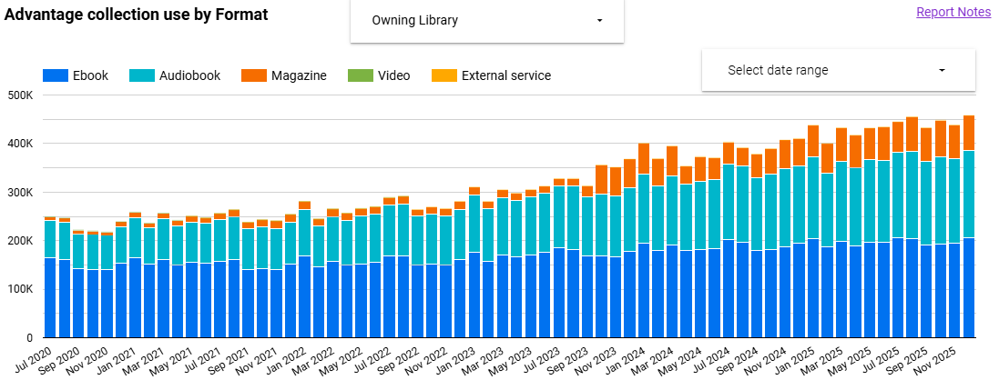
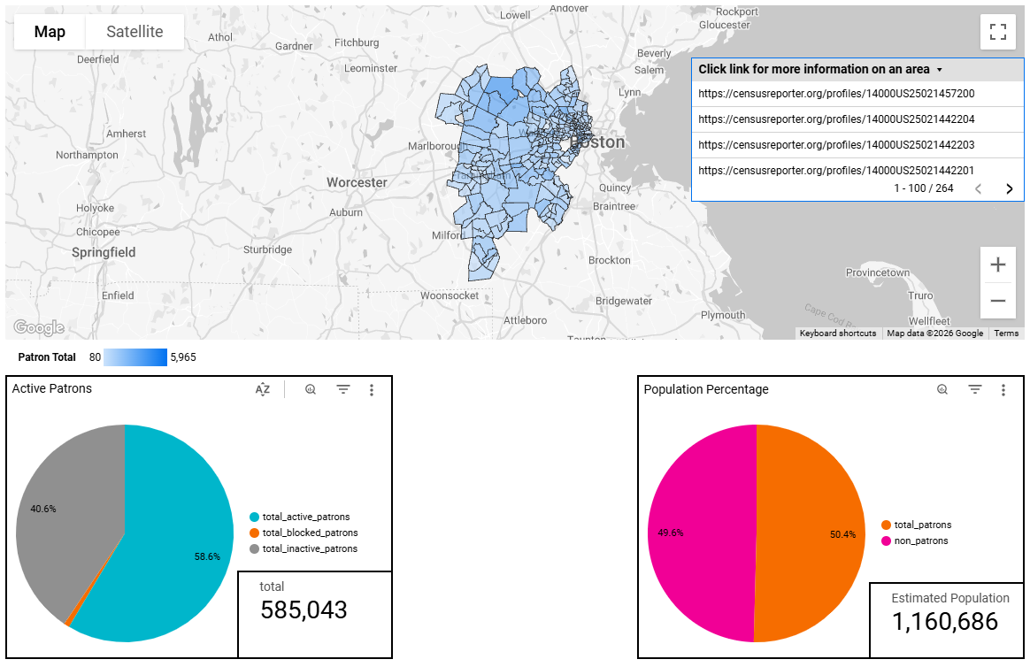
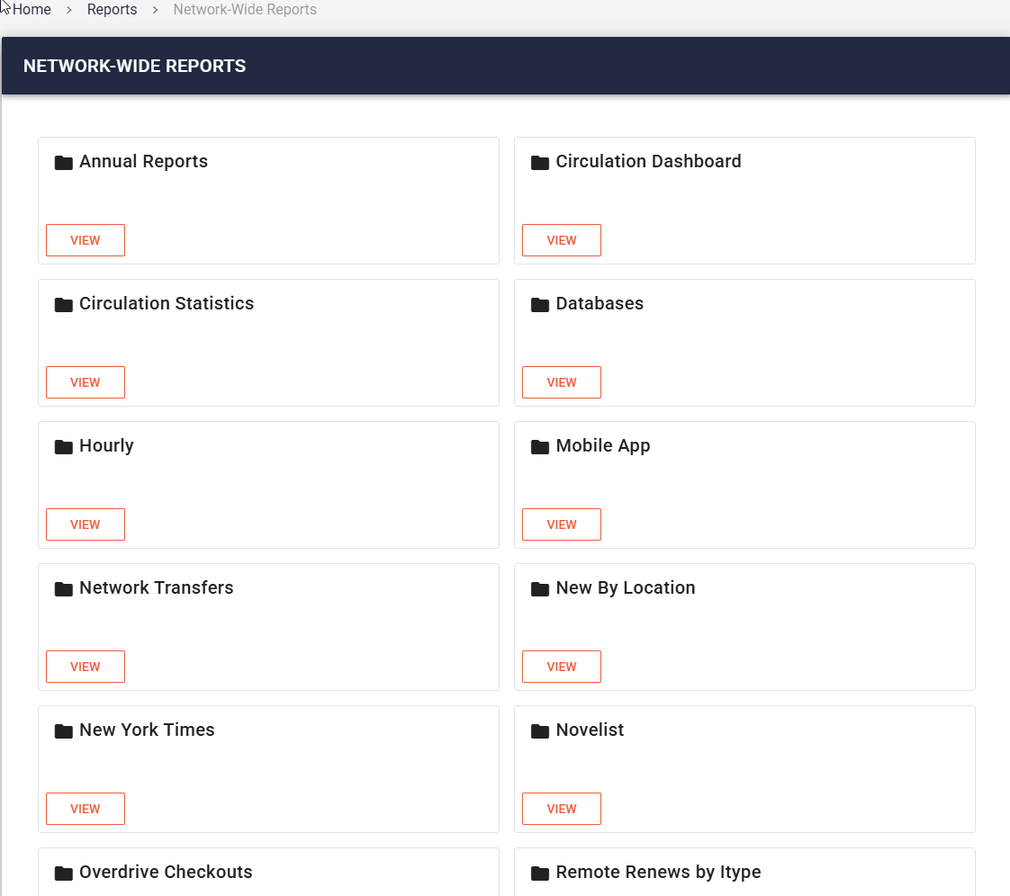
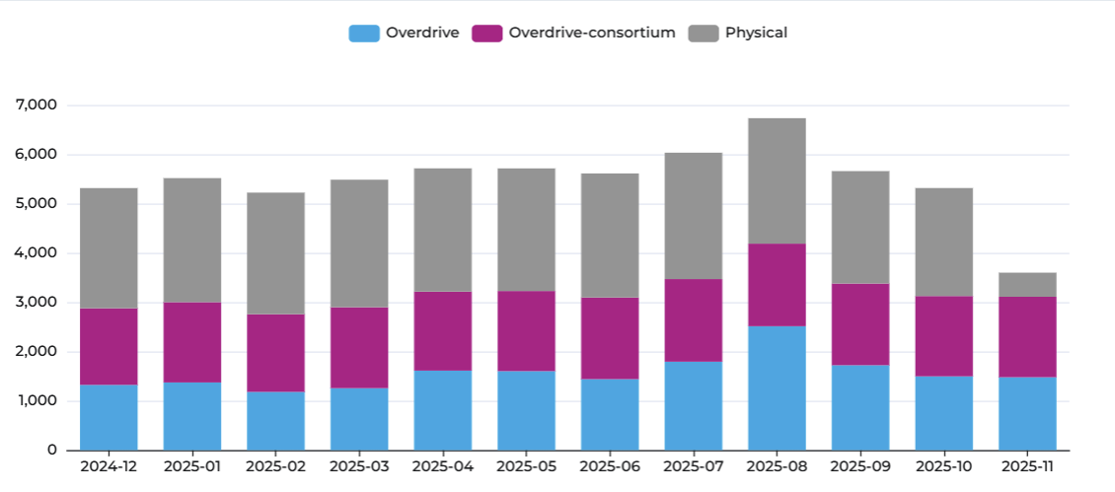
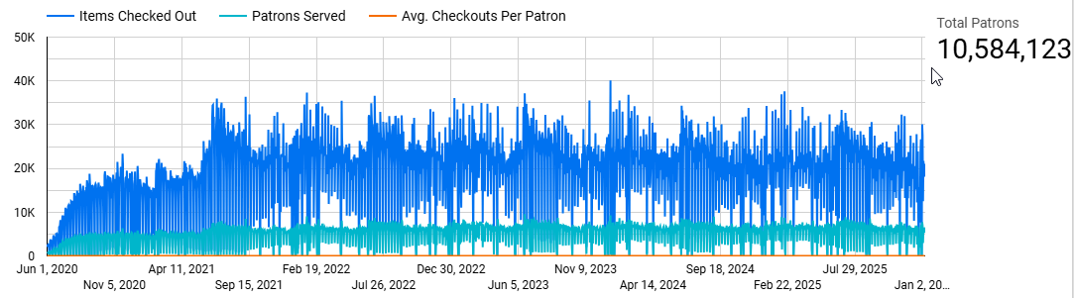
And Yet...Data
Notes:
And yet we still have data….lots of data…and lots of reporting options to go with that information…so let’s get into how we try to strike the balance between our two conflicting needs.

Slide 52
Approach
Data Minimization
Store the bare minimum long term
Aggregate what we can
Avoid patron details as much as possible
Access Minimization
Report tools separate user access from raw data
Limit third party access to everything
Notes:
We mainly try to follow some security basics. Minimize the data we store to what’s essential and limit who has access to that data where we can. When we store data outside the system we do so in aggregate form, just counts of transactions by various combinations of fields. And really try to eliminate as much patron information as we possibly can, though it’s not always possible especially when it comes to working with some third parties.
On the access front the reporting tools we create provide end users data views through canned sql reports and dashboards that generally keep them at a remove from the raw data. No one outside the admins at our consortia office have sql access and we are very cautious with API keys we may give out. For third parties such as libraryIQ that we work heavily with, and I quite literally work for as a contractor in the interest of full disclosure, we send them daily extracts of the data they need as opposed to providing them their own access to our instance of Sierra.

Slide 53
What We Can’t Answer
How many times did a patron come to the library in the last year?
Which patrons have been the heaviest users of our hotspots?
Which patron checked out a particular item, 2 checkouts ago?
* What was the most checked out title of 2025?
Notes:
Because of our limited data, there are data requests that come through regularly that we can’t actually answer or can’t answer exactly. For the remainder of my time here I’m going to review of few of these to show some how we may address some of these scenarios

Slide 54
How many times did a patron come to the library in the last year?
Lack the transaction history to pick out individual days when the patron recorded a transaction
Transaction aren’t everything, system never records online use, program attendance, etc.
Notes:
To start off with, how many times did a patron come to the library in the last year? Because our transaction history only goes back 5 weeks and because patron records don’t have a field for counting this sort of information there simply isn’t data to work with…but even if there were that still wouldn’t tell the whole story about a given patron’s usage of the library. Things like program attendance never get recorded so there are many cases when a patron may visit the library that the system would never know about.

Slide 55
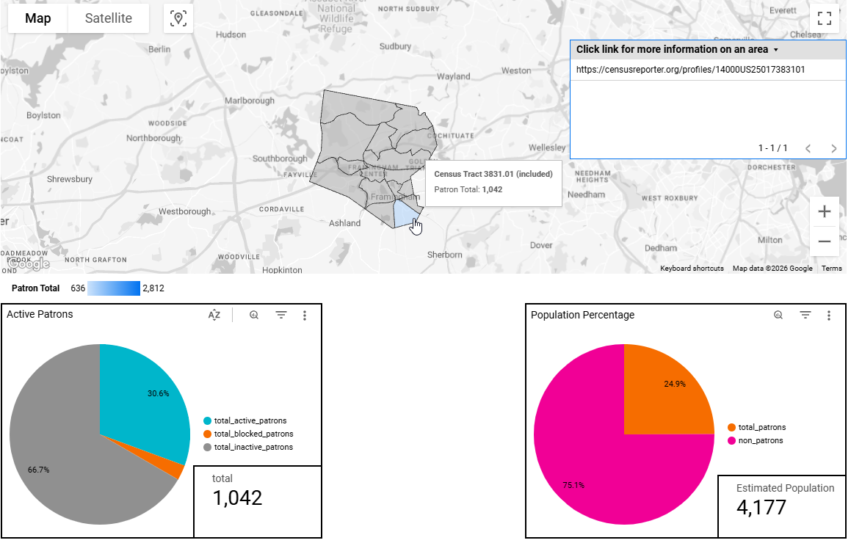
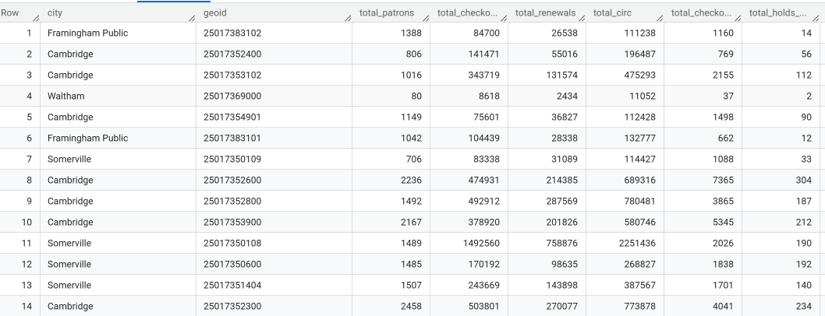
What We Can Answer Instead
Which communities are we succeeding/failing to serve?
Notes:
So we can’t gather data on individuals…but that micro level of information isn’t actually that useful anyway…unless you’re doing something like targeted marketing I suppose and we don’t have time to get into that. So instead let’s look at what can be accomplished with the macro view of patron activity.
Here’s the patron map some of you may have seen earlier if you came to my speed geeking session. This provides tons of valuable data on which neighborhoods are using the library and which aren’t. Staff have a useful and intuitive interface for exploring the data, that’s locked down easily to people with a valid email in our domain…just using Google accounts essentially the same as sharing a doc, while not having direct access to the underlying database…not that there’s anything particularly harmful for them to access in this table. We’re not exposing names, addresses, record numbers, anything that could be remotely considered sensitive information. The aggregate data here is far more meaningful than the granular data about individuals

Slide 56
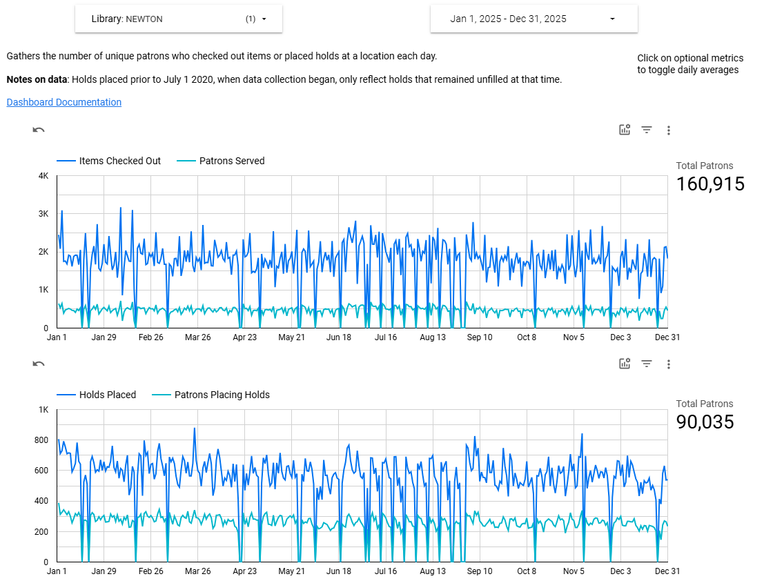
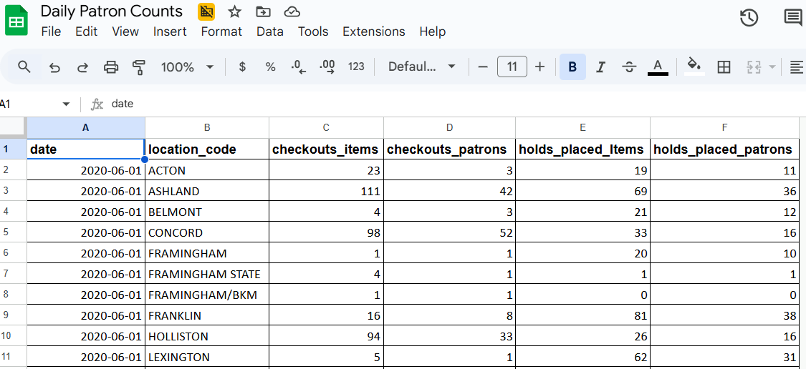
What We Can Answer Instead
How many individuals checked out at the library each day?
Notes:
For something that could be more sensitive in nature if you’re not aggregating, here’s a dashboard providing the daily count of unique patrons who used every one of our locations going back to the early pandemic. To gather up unique users counts, you need to actually look at record identifiers, barcodes or record numbers, PII where we really don’t want to retain a record of an individual’s usage patterns. So instead we’re just taking the daily aggregate total for each location and storing that. There are tradeoffs with this of course, I can’t use this data for different timeframes to say how many unique individuals used the library in a week, how many used the library multiple times in a month, any of that. Nice things to do but also those answer questions that we generally aren’t being asked. So we’ve got minimum viable data here that works for the primary use case staff have, how busy does the desk get.

Slide 57
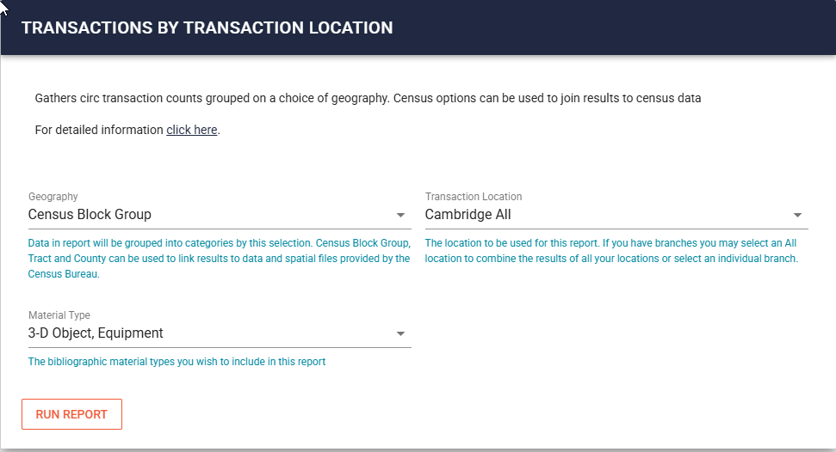
Which Patrons Are the Heaviest Users of Our Hotspots?
Which locations should have the most inventory given hotspots are not placed in delivery?
How can we track usage patterns without storing reading history?
Notes:
This question came to me recently from the Cambridge library where they have a number of branches and were interested in finding a way to calculate how they should distribute their hotspots among them to best pair their inventory with the interested population given that the hotspots are not sent out through delivery.
Aggregate data to the rescue. We’ve already seen a map of cardholders, that’s possible because we’ve been geocoding our patrons records, which allow us to aggregate patrons at a number of geographic levels from the not terribly informative (county, nearly all our patrons live in one of two) to the extremely granular (census block groups). This allows us to anonymize activity while still being able to pinpoint fairly narrow portions of our community.

Slide 58
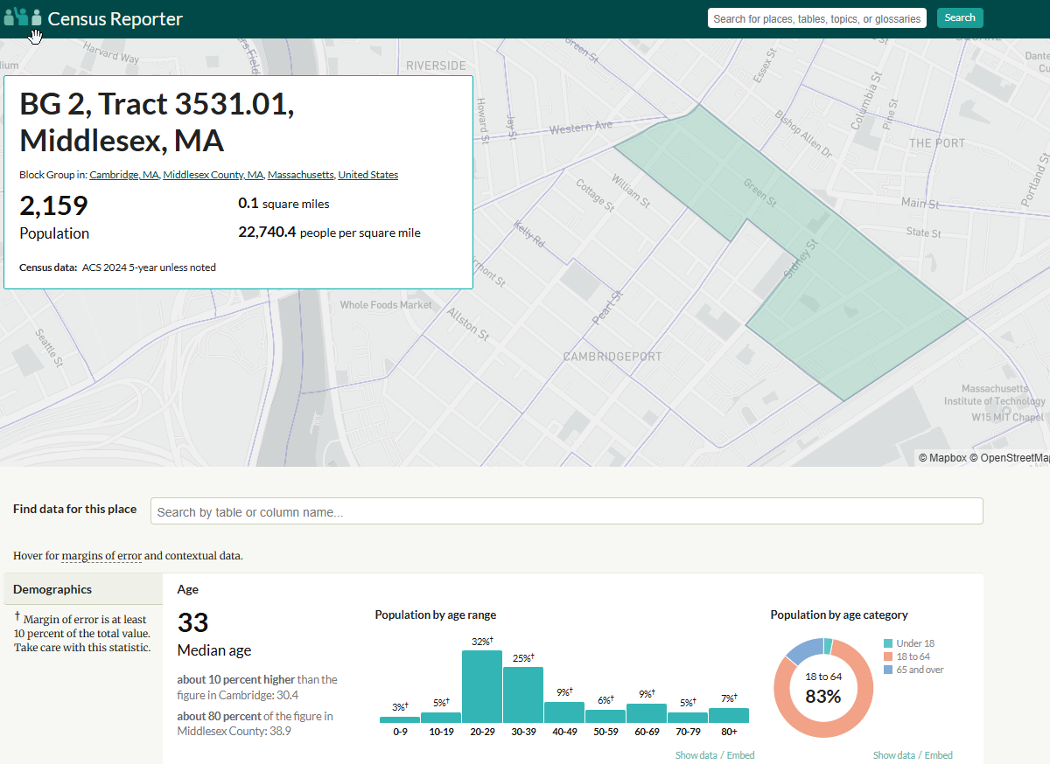
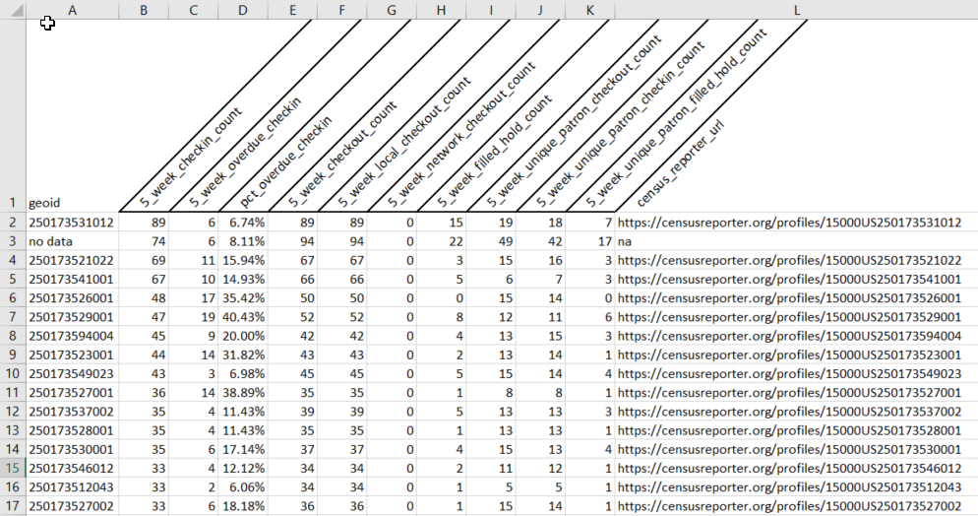
Which Patrons Are the Heaviest Users of Our Hotspots?
Notes:
With that data you can match your data to a Tigerline shapefile matching your area, available freely from the Census Bureau, or just click on one of the produced links to view the information for a particular region the Census Reporter site, which I love. The top area here happens to cover Central Square, which falls directly between the MIT and Harvard campuses and incidentally there’s a branch right in the center of that area, that’s also within a block of a major transit hub. Now the caveat with this is we only have access to a month of data because of our retention policies, but this is data that could be extracted and stored in order to accumulate data over time without compromising patron privacy.

Slide 59
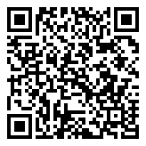
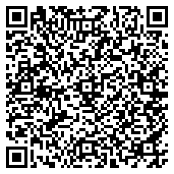
Which Patrons Are the Heaviest Users of Our Hotspots?
Geocoding Script
Transactions by Geography Query
Notes:
If you’re interested in digging into how we build these geography based reports the script used for geocoding our patrons records is available in our repo, as is the sql query used to build the report we were just viewing, though that one is a little Minuteman specific.

Slide 60
Which patron checked out a particular item, 2 checkouts ago?
Staff check in an item and are then informed the item was damaged by the prior patron
If 5 weeks have elapsed since that check in, that data is gone and the lpatron field now reflects this most recent transaction instead
Notes:
This question is one that comes down to addressing an occasion edge case at the circ desk where a staff member checks in an item, which overwrites the last patron field and later the item is reported as having been damaged, or missing a disk, or something like that.
Is it helpful to track down that former patron to address the damage. If it’s to track down a disc that might still be in the other patron’s dvd player…maybe. But is the rare time that comes up worth maintaining that data for every transaction for every patron long term…especially when staff with the ability/permissions to query it are limited…not particularly. At least for us as a somewhat privileged group of libraries that are fully fines free and more often than not struggle to spend down their materials budgets by the end of the fiscal year anyway. Give that patron a pass and just buy the replacement copy if demand warrants it.

Slide 61
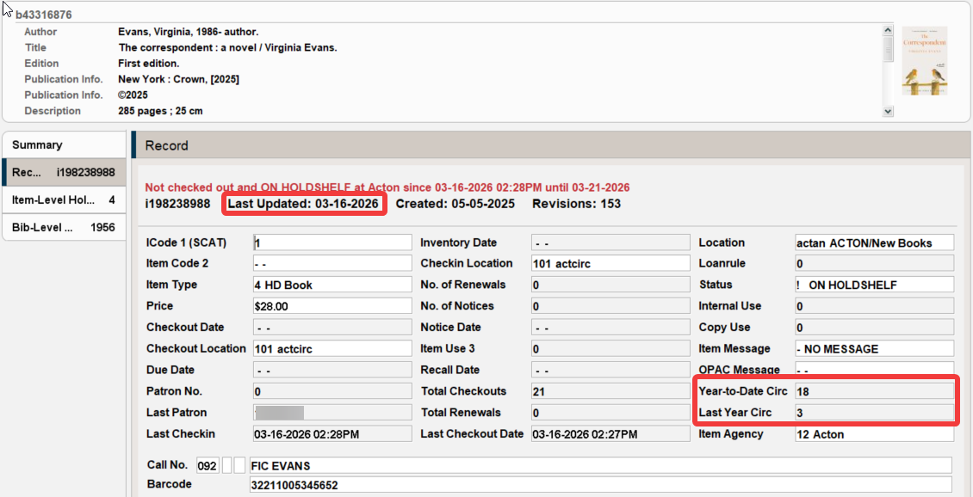
What was the most checked out title of 2025?
Our YTD and LYTD circ fields are fiscal year based
Notes:
Finally let’s look at the top question that we can’t fully answer and it’s something pretty ordinary on the surface, what are the top circulating titles from last year. Sierra has fields for tracking year to date and last year to date checkouts for each item…though if you withdraw a copy that data is of course lost. But we can’t use those fields for this purpose because our system configured to base those around the fiscal and not the calendar year as we need that data for annual fiscal year reporting.

Slide 62
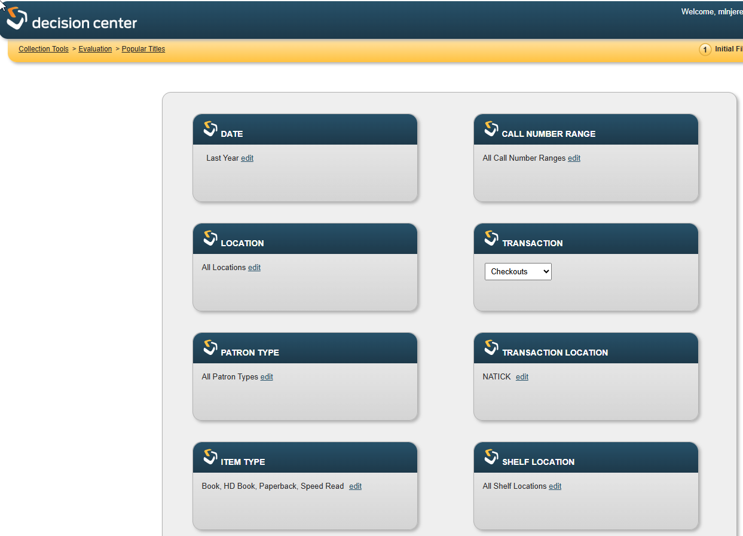
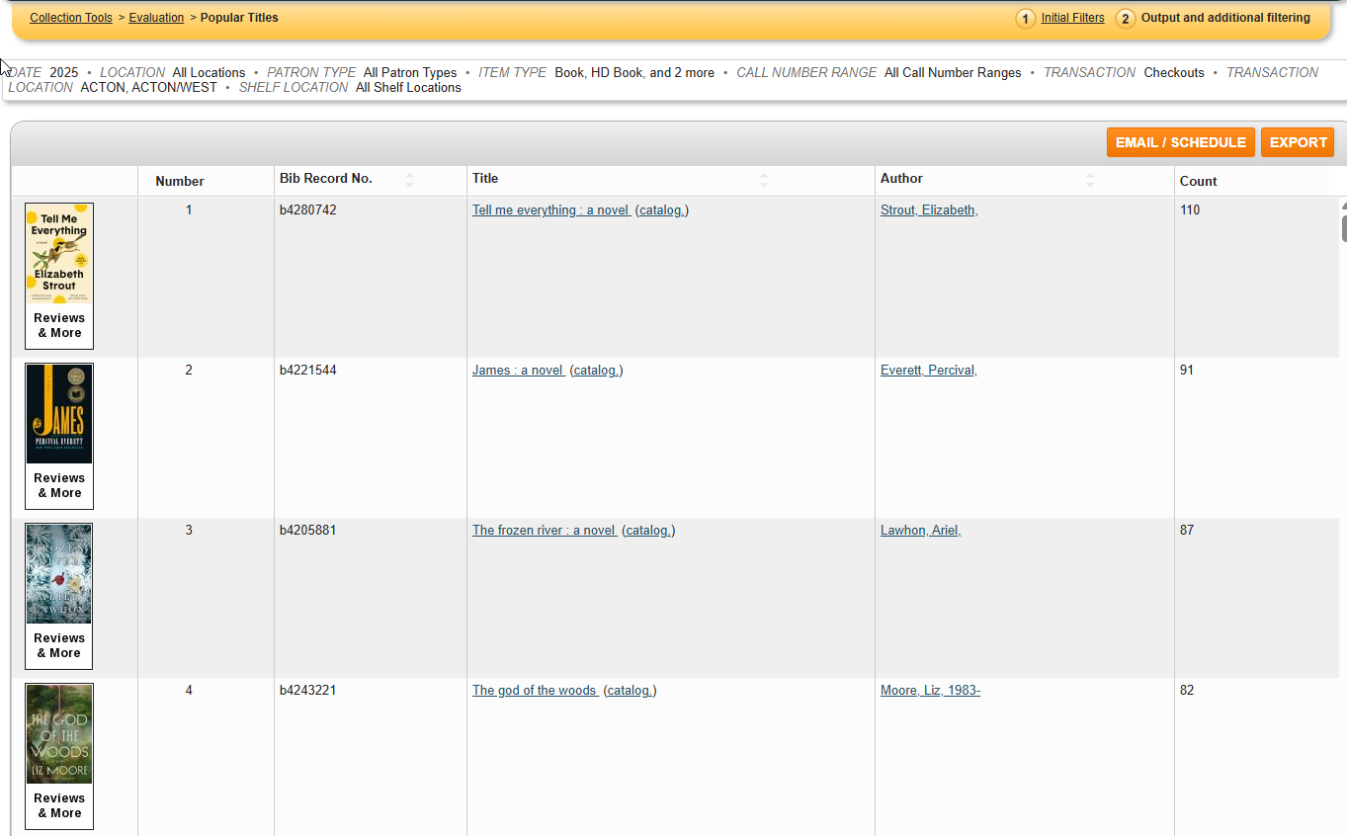
Imperfect Option
DC stores 3 years of data
It’s slow
It times out
It only returns the top 100
Notes:
There are a number of imperfect options that exist, which may be good enough, starting with Decision Center and the 3 years of transaction data it keeps without providing patron details beyond using a few fixed field options as filters. However, this report has problems, it’s ungodly slow, it regularly timesout without completing, and when it does work you only get the top 100 titles matching your filters, and if you weren’t careful with your filters most of those top 100 will be occupied by things like circulating tote bags and the Pokemon manga that is all on one serial record…accurate but not what you want…which goes to show that what checked out the most isn’t necessarily what you actually want anyway

Slide 63
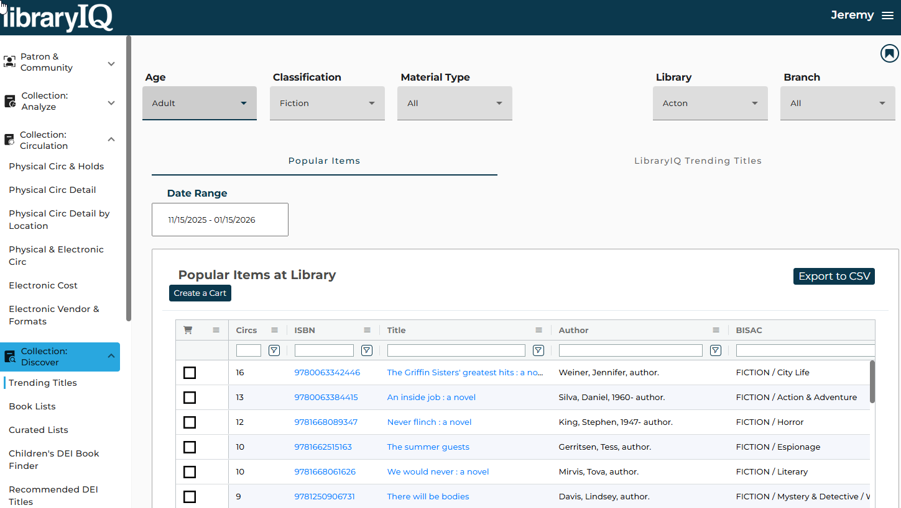
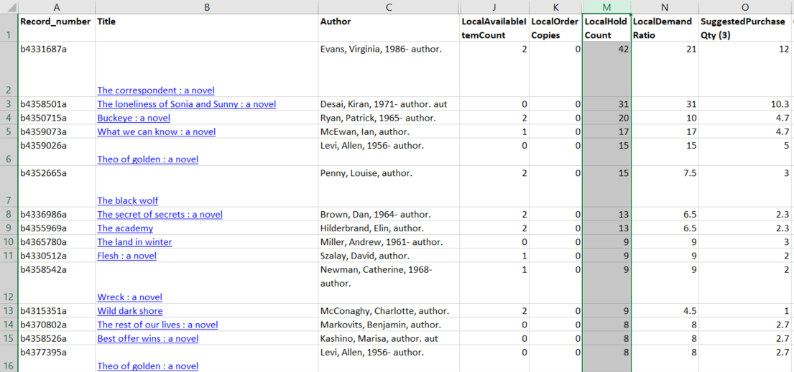
More Options
libraryIQ Trending Titles
Most circs of items in collection
Minuteman Purchase Alert
Outstanding holds for pickup location
Notes:
There are other close but not quite options that are somewhat readily available.
libraryIQ does store transaction history for a couple years, but as the tool is primarily focused on assessing your collection staff mostly can’t look at the trends involving other library’s materials that passed through their location. There’s one exception to that in there currently but it happens to work with item level details as opposed to title level rollups.
Our purchase alert is our take on the high demand holds report native to Sierra, but accounting for orders, consortia data, and just generally fancier. So it’s looking at unfilled holds to measure present demand which isn’t an exact match for best of the year but may still get you to that ballpark. In this case the top items on the list wound up being quite different, and yet both are valid alternate ways to explore what’s popular or trending, among many others. If you’re paying close attention, please note that all 3 of these produced different results for the top of the list. None are wrong, there just is not single correct path

Slide 64
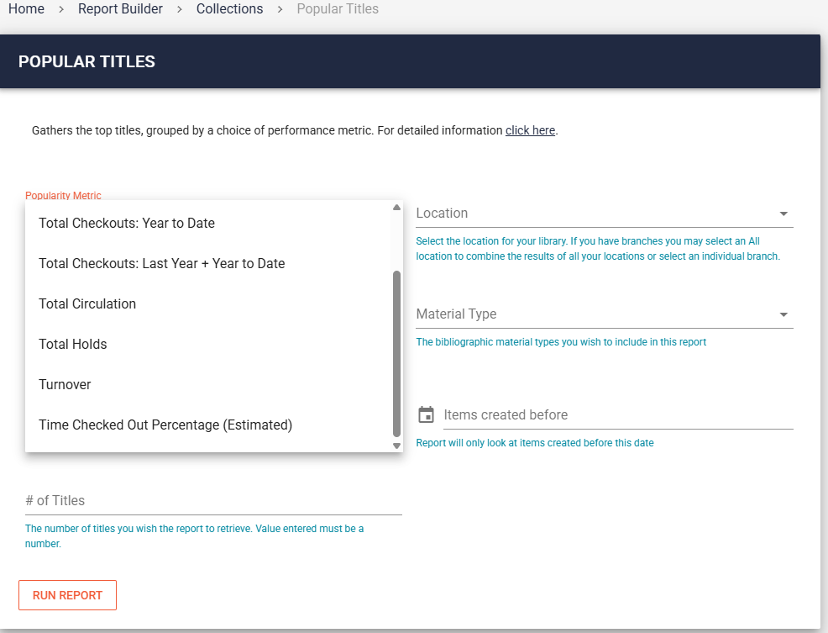
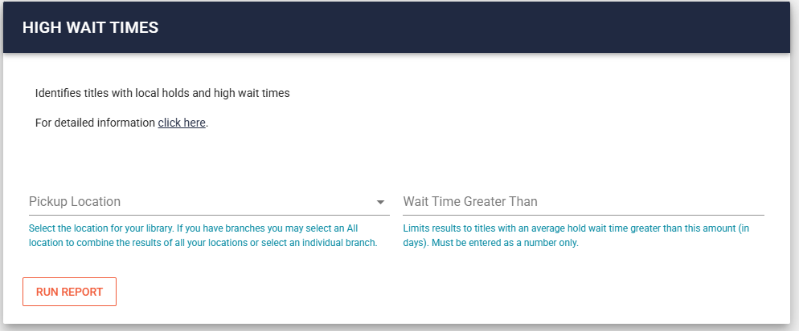
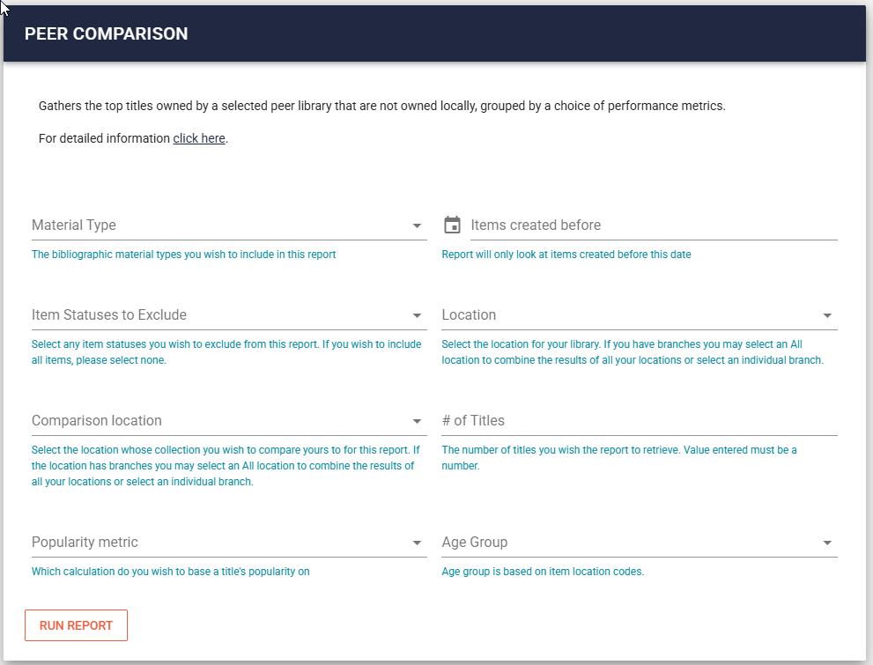
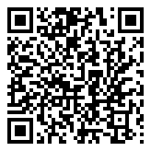
Even More Options
Notes:
This is from our canned reports site where we have a popular titles tool that will run a SQL query for staff based on the selected parameters. We have 8 different options available for how one might wish to define popularity, ranging from the straight forward (total circ, total holds, year to date checkouts) to the experimental (percent of time checked out based on an item’s age, the lifetime circ total and the avg loan period length for items sharing an itype based on current checkouts). We also have alt reports entirely to come at these sorts of questions from different approaches. What titles have high wait times, what’s popular at other libraries in the network, what titles have the most copies that are currently overdue
This shows how even without the precise data you may long for, with some creativity and advanced preparation you can still find ways to produce workable results that may provide meaningful information to fulfill your library’s needs.

Slide 65
Thank You!
Jeremy Goldstein
Minuteman Library Network
jgoldstein@minlib.net

Slide 66
Today’s Speakers
Derek Brown
Rochester Hills Public Library
derek.brown@rhpl.org
Jeremy Goldstein
Minuteman Library Network
jgoldstein@minlib.net
Wes Osborn
Central Library Consortium
wosborn@clcohio.org
Victor Zuniga
Poudre Libraries
VZuniga@poudrelibraries.org
Bob Gaydos
Stark County District Library
bgaydos@starklibrary.org
Daniel Messer
Library Systems and Services
Daniel.Messer@lsslibraries.com
Ray Voelker
Cincinnati & Hamilton County Public Library
Ray.Voelker@chpl.org
Notes:
Use for panel

Slide 67
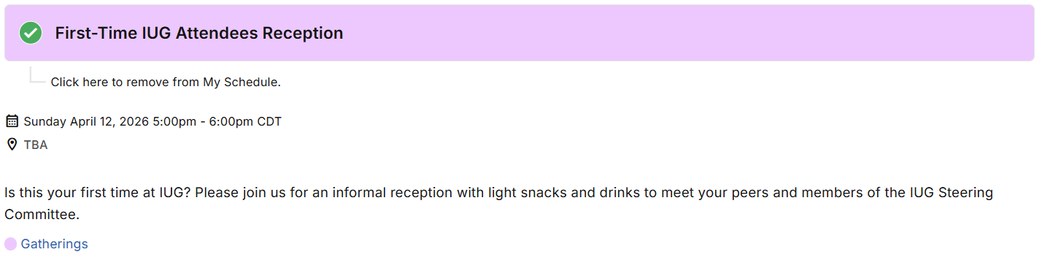
Up Next

Slide 68
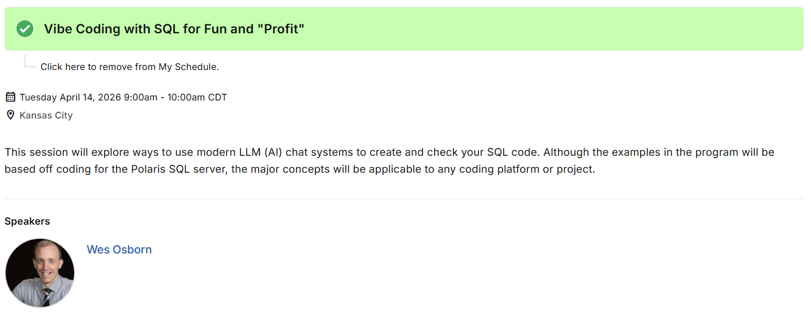
Tuesday Apr 14: There’s More!

Slide 69

Tuesday Apr 14: There’s More!

Slide 70
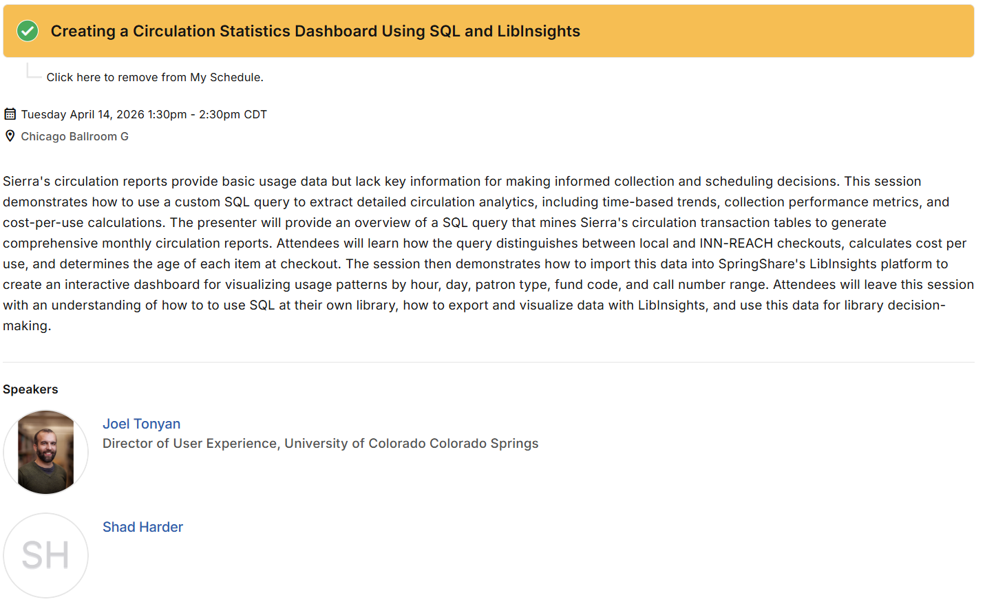
Tuesday Apr 14: There’s More!

Slide 71
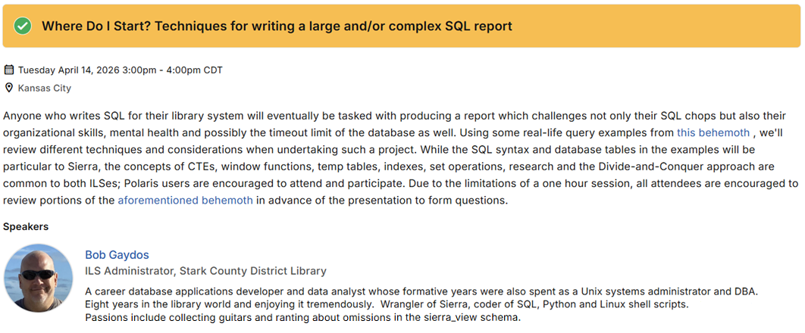
Tuesday Apr 14: There’s More!

Slide 72
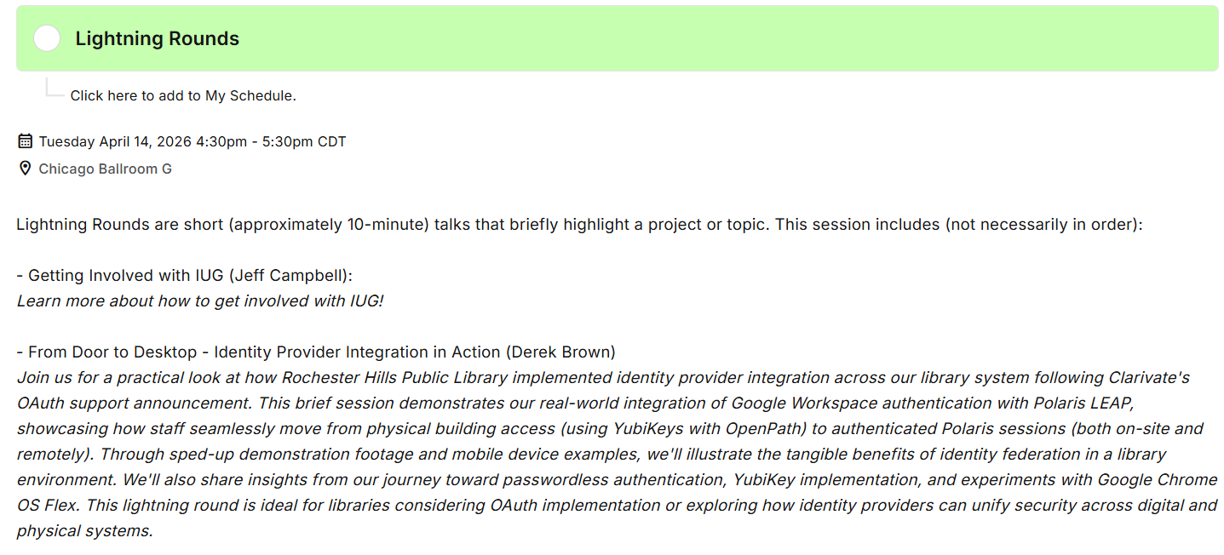
Tuesday Apr 14: There’s More!

Slide 73
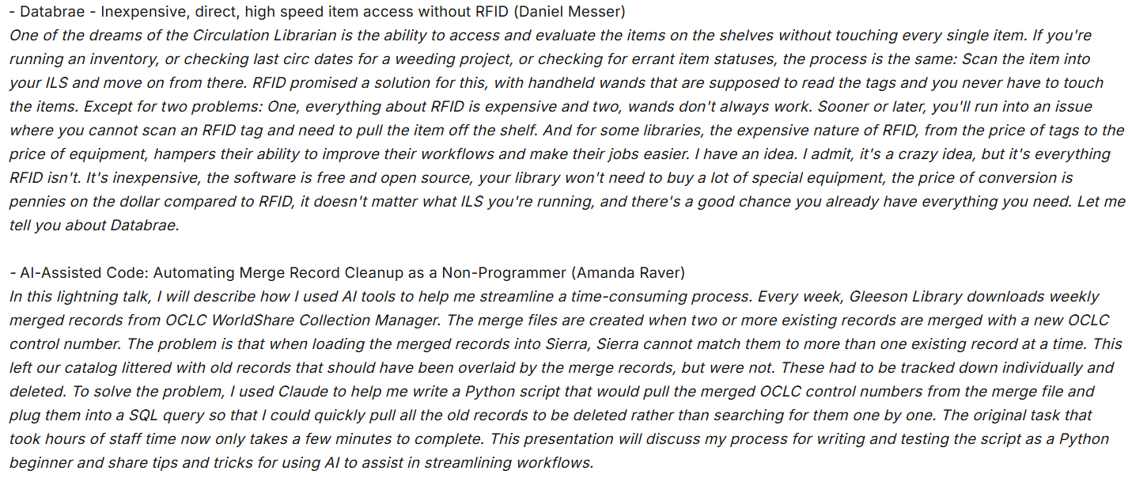
Tuesday Apr 14: There’s More!
Notes:
Lightning Rounds Continued

Slide 74


Find Us Online
IUG Discord
https://discord.gg/HwZVjN5wAn
IUG Forum
https://forum.innovativeusers.org/

